Slide 1
Austrian climate policy – updates
EDGAR 7.0 → EDGAR 8.0
Addition: biofuels on top of fossil fuels
Addition: methane (CH4), nitrous oxide (N2O) and F-gases on top of carbon dioxide (CO2)
All in GWP CO2-eq
Data up to 2022
Other data
GDP data updated up to 2022
Population data updated up to 2022
Samples
EU15 and EU31 → EU15, EU31, OECD, (and pseudo-countries EU15 and EU31)
Adds: Australia, Canada, Chile, Colombia, Costa Rica, Israel, Japan, Korea, Mexico, New Zealand, Türkiye, US

Slide 2
Approach
Framing
Extension of Austria paper, evaluating both country-level policies (covered under ESR) and EU-wide policies (covered under ETS)
Robustness checks using EU15, EU31 and OECD
Overview of all samples
Sample | EDGAR 7.0 (original) | EDGAR 8.0 (incl. biofuels & new gases)
EU15 | Done | To do
EU31 | Done | To do
OECD | Not done | To do
OECD with EU15 pseudo-country | Not done | To do
OECD with EU31 pseudo-country | Not done | To do
Progress to date
Data updated; data wrangling mostly complete
Data exploration underway
Code written for analysis; initial tests of analysis complete (runtime: approx. 10+ hours)
Repo: https://github.com/talistebecis/reverse_eu_pol.git

Slide 3
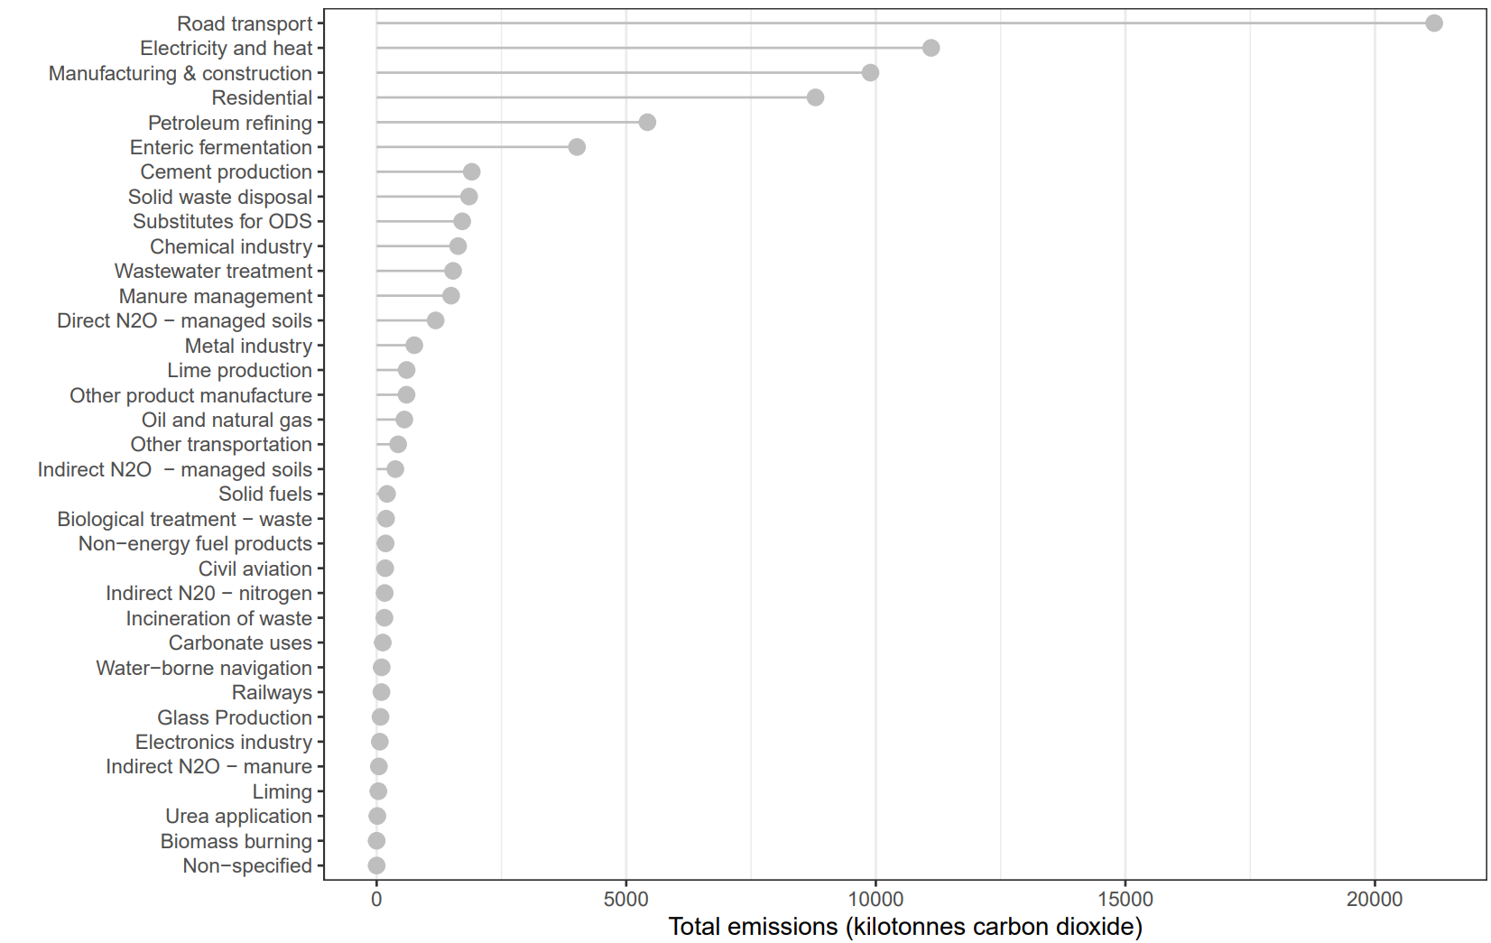
Austria total emissions 2022

Slide 4
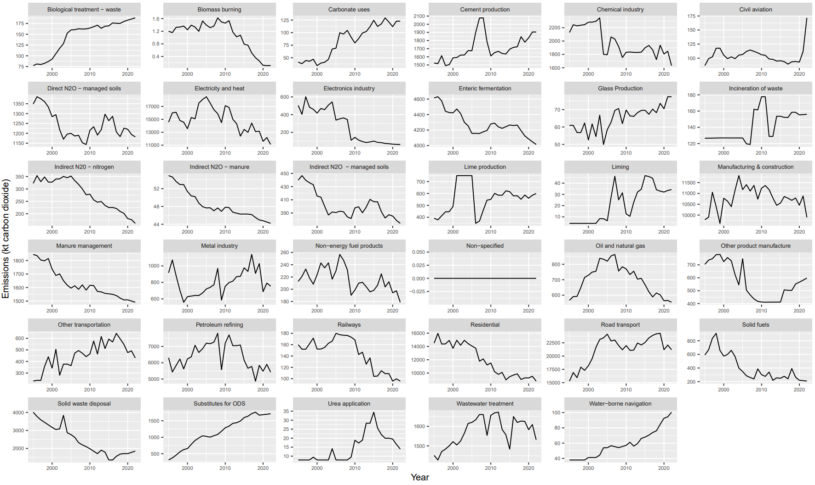
Austria emissions time series 1995-2022

Slide 5
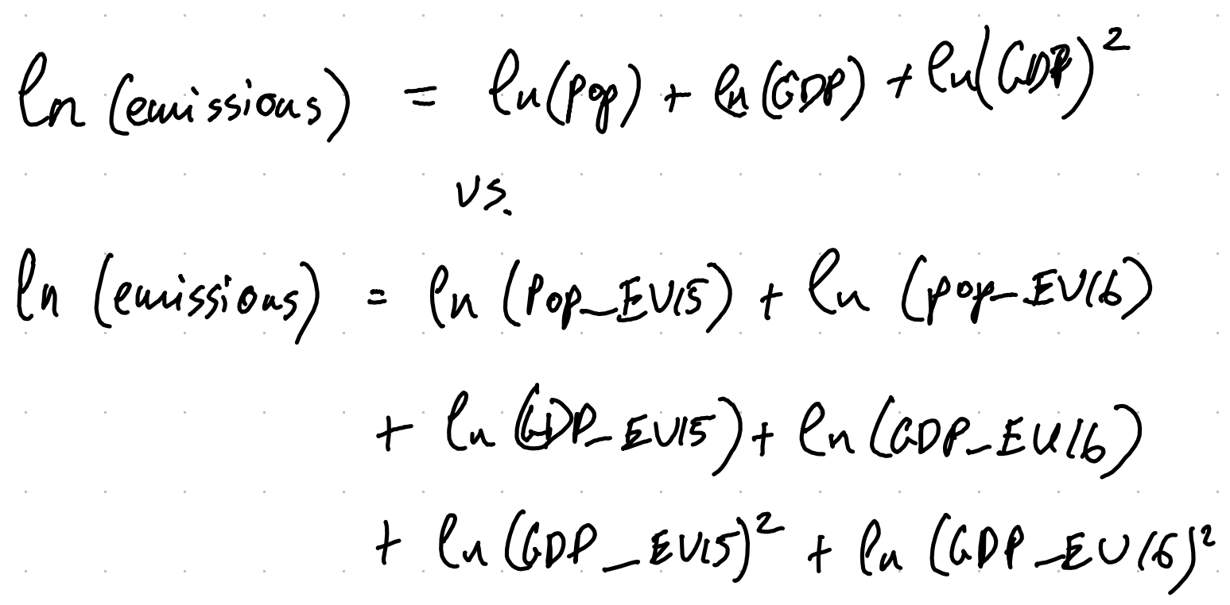
Questions
Does it make sense to use pseudo-countries? Will it cause issues?
Should I also look at Level 1 and Level 2 emissions? They did not add much in the original paper
Does including “heterogenous treatment effects” affect break identification? (below)

